Slide 1

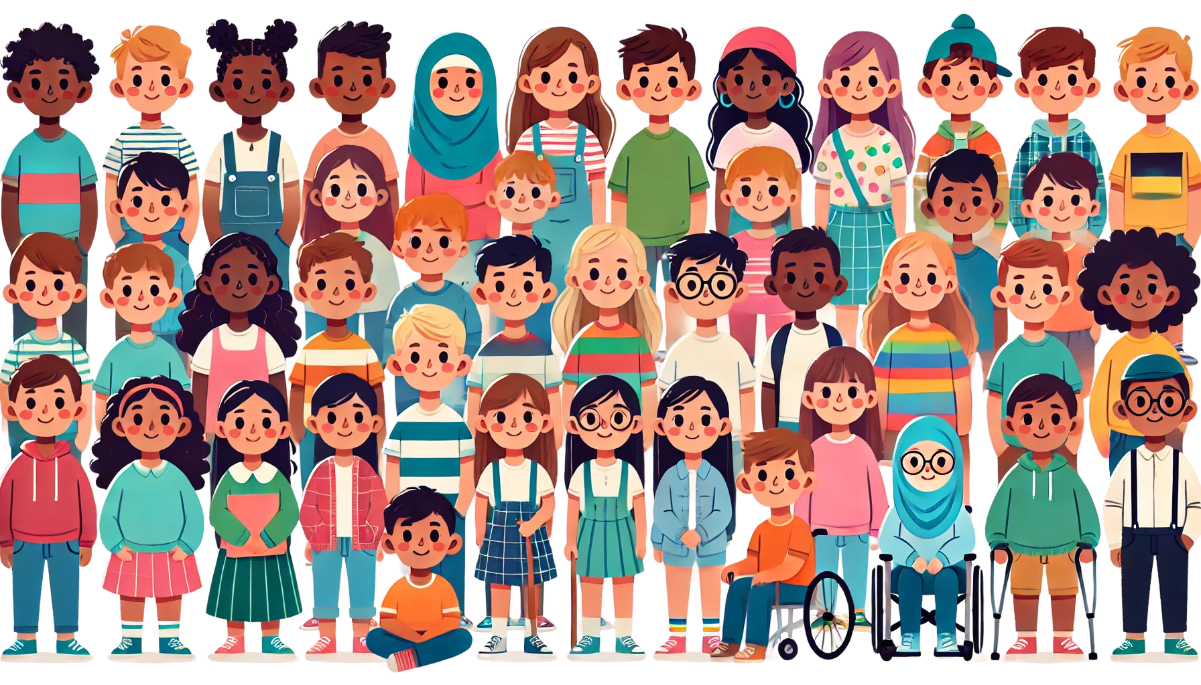

READY SET
GROW!
Session 2
GROWING UP
What's happening to my body?

Slide 2



Acknowledge the Traditional Owners

Slide 3
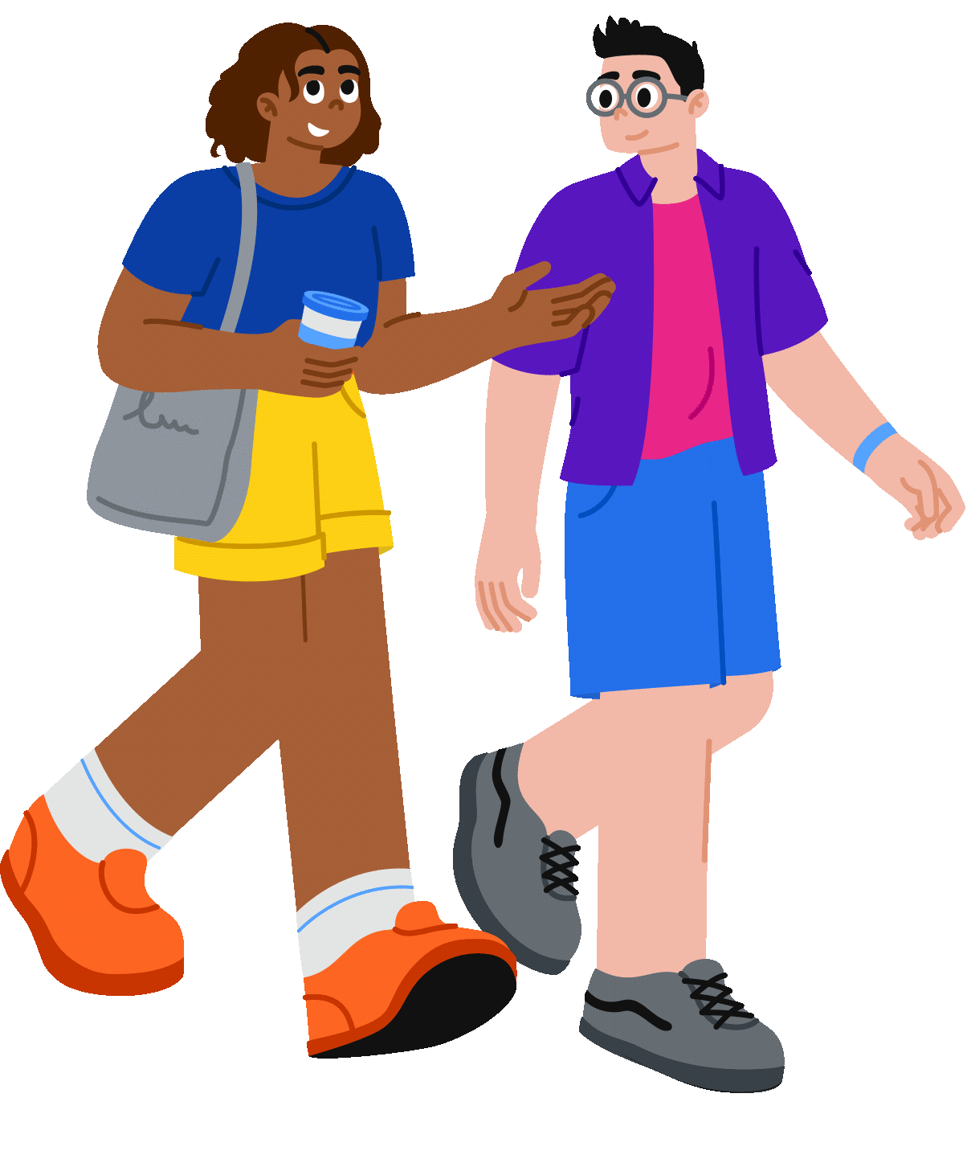

What’s happening today
  Puberty
  Anatomy

Slide 4

What’s happening today
READY SET
GROW!
Puberty definition
Puberty is the time when your body starts changing from a child’s body to an adult’s body. These changes happen to everyone but can look different for each person. It’s your body’s way of getting ready for the future, and it’s totally normal to go through these changes in your own way and at your own pace.

Slide 5

What’s happening today
READY SET
GROW!
RECAP
Be respectful and supportive of each other.
This is a safe space to share and learn.

Slide 6

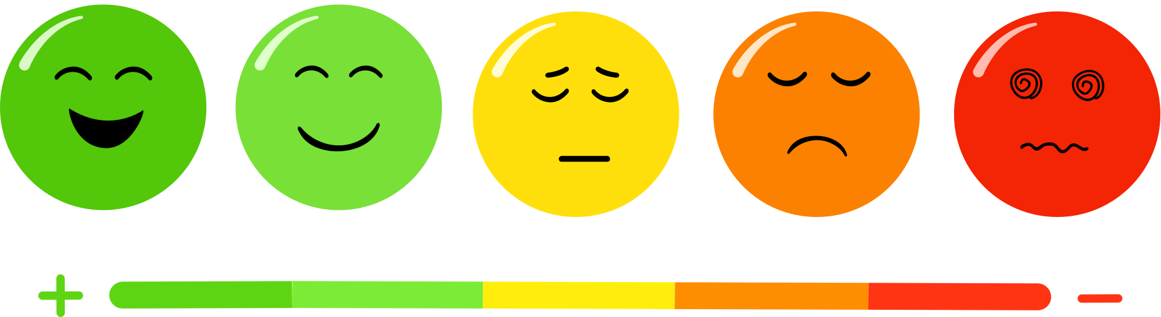
What’s happening today
READY SET
GROW!
How are you feeling about today’s session?
Circle one in your workbook:

Slide 7

Close your eyes and imagine
a safe place...
READY SET
GROW!
Take 3 deep breaths
Breathe in calm, and breathe out any worries.

Slide 8

Puberty myth busters game
READY SET
GROW!
Thumbs-up if you think it’s true or thumbs-down if it’s false. Then we’ll discuss each one!
FALSE:
THUMBS DOWN
TRUE:
THUMBS UP

Slide 9




Puberty myth busters game
READY SET
GROW!
Statement 1
“Puberty starts at the same age for everyone.”
FALSE:
TRUE:
THUMBS DOWN
THUMBS UP

Slide 10

Puberty myth busters game
READY SET
GROW!
Statement 1
“Puberty starts at the same age for everyone.”
FALSE:
Puberty can happen between 8 or 16, everyone’s different and that’s ok!
FALSE:
TRUE:
THUMBS DOWN
THUMBS UP

Slide 11

Puberty myth busters game
READY SET
GROW!
Statement 2
“Only boys’ voices change during puberty.”
FALSE:
TRUE:
THUMBS DOWN
THUMBS UP

Slide 12
Puberty myth busters game
READY SET
GROW!
Statement 2
“Only boys’ voices change during puberty.”
FALSE:
While boys often experience a deeper voice, everyone’s voice might change slightly
FALSE:
TRUE:
THUMBS DOWN
THUMBS UP

Slide 13
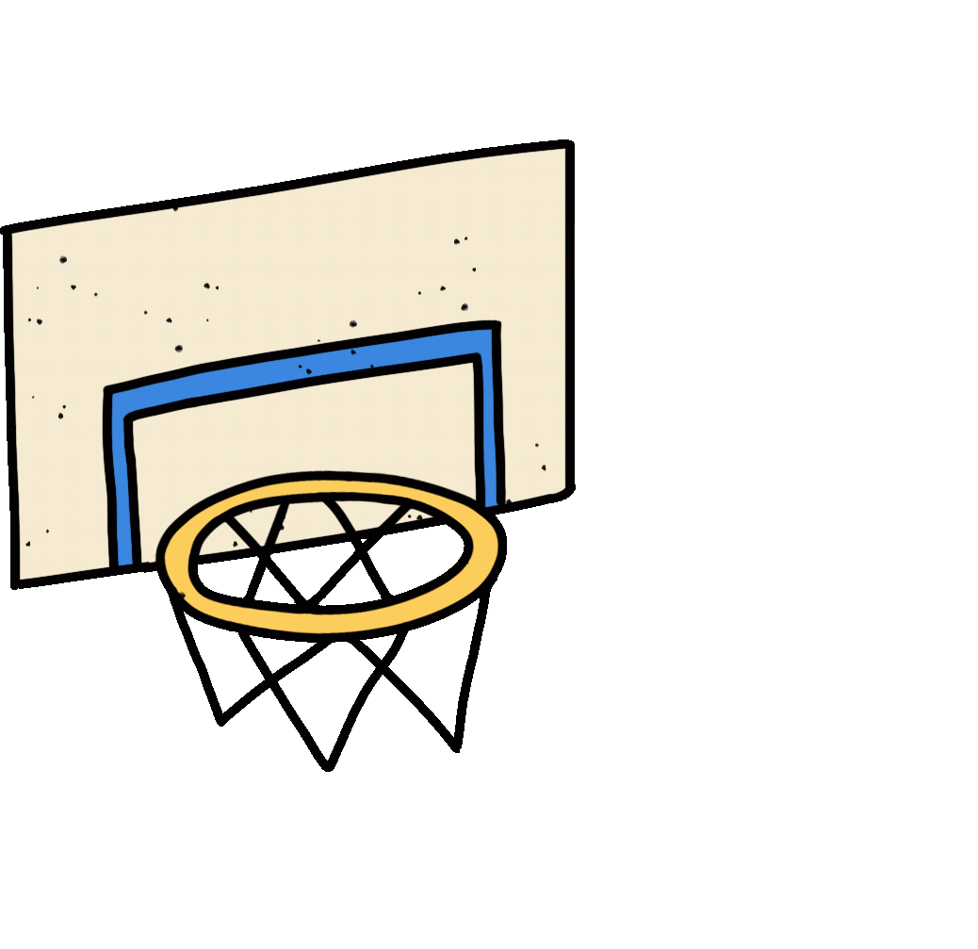
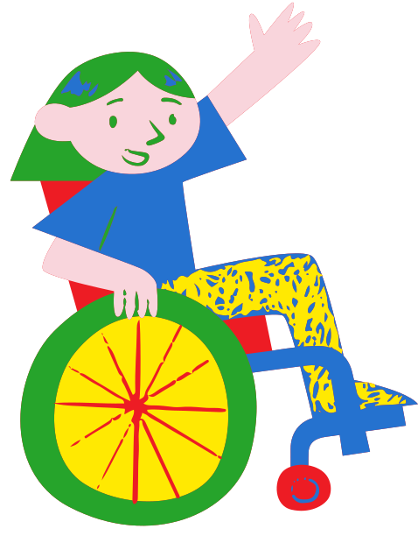
Puberty myth busters game
READY SET
GROW!
Statement 3
“People with disability experience puberty in the same way as others.”
FALSE:
TRUE:
THUMBS DOWN
THUMBS UP

Slide 14

Puberty myth busters game
READY SET
GROW!
Statement 3
“People with disability experience puberty in the same way as others.”
TRUE:
Most people will go through puberty, regardless of ability, though some changes might be experienced differently or at a different pace.
FALSE:
TRUE:
THUMBS DOWN
THUMBS UP

Slide 15
Puberty myth busters recap
READY SET
GROW!
Statement 1
Statement 2
“Puberty starts at the same age for everyone.”
“Only boys’ voices change during puberty.”
In your workbook, circle whether the statement is true or false.
Statement 3
“People with disability experience puberty in the same way as others.”

Slide 16


Why does it happen?
READY SET
GROW!
Video 1
Great work!
Now let’s watch a short video that explains why puberty happens.
PRESS PLAY

Slide 17




Video reflection
READY SET
GROW!
Let’s discuss and/or write your thoughts in your workbook
  Why is it important to understand the facts about puberty?
What’s one thing from the video that surprised you?

Slide 18
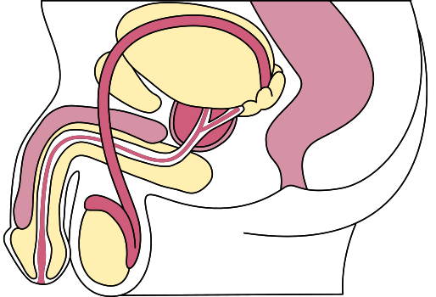
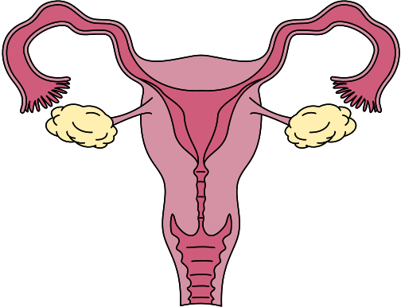
READY SET
Your anatomy
GROW!
Introduction to body parts and what they do.

Slide 19
Role of the female reproductive system
READY SET
GROW!
The female reproductive system helps the body prepare for pregnancy.
The ovaries store tiny eggs. Each month, an egg travels through the fallopian tube to the uterus.
If a male sperm joins the egg, it can grow into a baby. If not, the body removes it, which is called a period.
Special hormones control these changes, coming from the ovaries and the brain.

Slide 20




Role of the female reproductive system
READY SET
GROW!
CLITORIS
VULVA
A small, sensitive part at the top of the vulva.
The outer part of the female private area. It includes the labia (lips), the opening to the vagina, and the clitoris. It protects the inside of the body and helps with hygiene.
LABIA
The folds of skin around the opening of the vagina

Slide 21


Role of the female reproductive system
READY SET
GROW!
VAGINA
A stretchy tube that connects the uterus to the outside of the body. It is where period blood leaves the body and where a baby comes out during birth.

Slide 22


Role of the female reproductive system
READY SET
GROW!
CERVIX
A small ring of muscle at the bottom of the uterus. It keeps a baby inside during pregnancy and opens during birth.

Slide 23


Role of the female reproductive system
READY SET
GROW!
UTERUS
A muscular organ with a soft lining. If an egg joins with a sperm, it can grow into a baby inside the uterus. If not, the lining leaves the body as a period.

Slide 24


Role of the female reproductive system
READY SET
GROW!
OVARIES
Two small organs in the female body. They hold tiny eggs from birth and release one each month as part of the menstrual cycle. The ovaries also make hormones, which help control periods and other body changes during puberty.

Slide 25


Role of the female reproductive system
READY SET
GROW!
FALLOPIAN TUBES
Two small tubes that connect the ovaries to the uterus. This is where the egg travels after being released from the ovary.

Slide 26

Guess the body part!
READY SET
GROW!
Time to move around
Get into groups and work together to work out which bit goes where!

Slide 27

Guess the body part!
READY SET
GROW!
FEMALE REPRODUCTIVE SYSTEM

Slide 28
Role of the male reproductive system
READY SET
GROW!
The male reproductive system helps make sperm.
The testicles produce tiny sperm. The sperm travel through the sperm ducts and pass through the urethra in the penis, where they can leave the body during sexual intercourse.
If sperm joins with an egg from the female, it can grow into a baby.
Hormones control these changes, coming from the testicles and the brain.

Slide 29
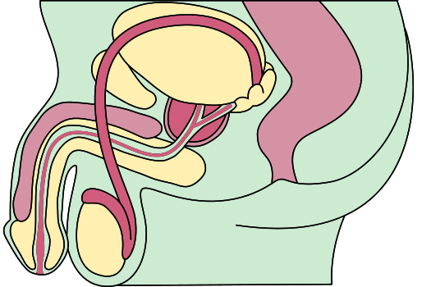
Role of the male reproductive system
READY SET
GROW!
PENIS
The part of the male body used for urination and sexual intercourse. It’s made of soft, spongy tissue with blood vessels. The urethra is inside the penis, and both urine and sperm pass through it to leave the body.

Slide 30
Role of the male reproductive system
READY SET
GROW!
FORESKIN
The foreskin is a fold of skin that covers the tip of the penis. It can be pulled back to clean and by doing so, will loosen over time.

Slide 31
Role of the male reproductive system
READY SET
GROW!
TESTES
The male reproductive system has two testes. Their main jobs are to make millions of sperm and produce hormones. These hormones help the male body change and grow during puberty.

Slide 32
Role of the male reproductive system
READY SET
GROW!
SCROTUM
A bag of skin that holds the two testes.

Slide 33
Role of the male reproductive system
READY SET
GROW!
GLANDS
There are different glands in the male reproductive system. These glands make fluids that mix with sperm to give them nutrients and help with urine flow.

Slide 34
Role of the male reproductive system
READY SET
GROW!
URETHRA
A tube that carries urine from the bladder and sperm from the testes out of the body through the penis.

Slide 35
Guess the body part!
READY SET
GROW!
Time to move around
Get into groups and work together to work out which bit goes where!

Slide 36
Guess the body part!
READY SET
GROW!
MALE REPRODUCTIVE SYSTEM

Slide 37

READY SET
GROW!
Female puberty guide

Slide 38


READY SET
GROW!
Changes to your body
You might grow taller and your body shape will change.
Breasts start growing (one might grow faster – that’s okay).
Hair grows under arms, on legs, and near your private parts.
  Female
  Your puberty guide

Slide 39
READY SET
GROW!
Changes to your body
  Your vulva changes and you might get white discharge.
  You might smell more – time for deodorant!
  Skin may get oily and pimples can appear.
  You’ll get your period – a small amount of blood from the uterus each month.
You might grow taller and your body shape will change.
Breasts start growing (one might grow faster – that’s okay).
Hair grows under arms, on legs, and near your private parts.
  Female
  Your puberty guide

Slide 40
READY SET
GROW!
Changes to anatomy
Breasts grow and change shape.
The vulva and labia grow, and the vagina produces discharge.
The uterus begins monthly cycles, leading to periods (menstruation).
  Female
  Your puberty guide

Slide 41
READY SET
GROW!
Changes to feelings
Changes to anatomy
You might feel happy one minute, then annoyed the next – that’s normal.
You might start liking someone in a special way – that’s okay too.
You might want more freedom or start questioning rules – that’s part of growing up.
Breasts grow and change shape.
The vulva and labia grow, and the vagina produces discharge.
The uterus begins monthly cycles, leading to periods (menstruation).
  Female
  Your puberty guide

Slide 42
Info sheet in your workbook
READY SET
GROW!
Changes to your body
Changes to anatomy
  Breasts grow and change shape.
  The vulva and labia grow, and the vagina produces discharge.
  The uterus begins monthly cycles, leading to menstruation (periods).
You might grow taller and your body shape will change
Breasts start growing (one might grow faster – that’s okay)
Hair grows under arms, on legs, and near your private parts
Your vulva changes and you might get white discharge
You might smell more – time for deodorant!
Skin may get oily and pimples can appear
You’ll get your period – a small amount of blood from the uterus each month
Changes to feelings
You might feel happy one minute, then annoyed the next – that’s normal
You might start liking someone in a special way – that’s okay too
You might want more freedom or start questioning rules – that’s part of growing up
  Your puberty guide
  Female

Slide 43
READY SET
GROW!
Male puberty guide

Slide 44

READY SET
GROW!
Changes to your body
You might grow taller and get more muscle.
Your voice might crack or get deeper.
Hair grows on your face, body, and near your private parts.
  Male
  Your puberty guide

Slide 45
READY SET
GROW!
Changes to your body
Penis and testicles grow (one may hang lower – that’s normal).
You’ll sweat more – time for deodorant!
Skin may get oily and pimples can appear.
Erections and wet dreams can happen – this is normal.
You might grow taller and get more muscle.
Your voice might crack or get deeper.
Hair grows on your face, body, and near your private parts.
  Male
  Your puberty guide

Slide 46
READY SET
GROW!
Changes to anatomy
The penis and testicles grow.
Testicles begin producing sperm.
Erections and wet dreams become common.
  Male
  Your puberty guide

Slide 47
READY SET
GROW!
Changes to feelings
Changes to anatomy
You might feel happy, then annoyed – that’s hormones!
You might start liking someone or feel new emotions.
You may want more independence or question rules – that’s normal.
The penis and testicles grow.
Testicles begin producing sperm.
Erections and wet dreams become common.
  Male
  Your puberty guide

Slide 48
Info sheet in your workbook
READY SET
GROW!
Changes to your body
Changes to anatomy
  The penis and testicles grow.
  Testicles begin producing sperm.
  Erections and wet dreams become common.
You might grow taller and get more muscle.
Your voice might crack or get deeper.
Hair grows on your face, body, and near your private parts.
Penis and testicles grow (one may hang lower – that’s normal).
You’ll sweat more – time for deodorant!
Skin may get oily and pimples can appear.
Erections and wet dreams can happen – this is normal.
Changes to feelings
You might feel happy, then annoyed – that’s hormones!
You might start liking someone or feel new emotions.
You may want more independence or question rules – that’s normal.
  Your puberty guide
  Male

Slide 49
READY SET
GROW!
Everyone’s puberty guide

Slide 50

READY SET
GROW!
Changes to your body
Arms, legs, and feet grow fast – you might feel clumsy.
Everyone starts puberty at their own time.
Hair grows under arms, on legs, and near private parts.
  Everyone
  Your puberty guide

Slide 51
READY SET
GROW!
Changes to your body
Arms, legs, and feet grow fast – you might feel clumsy.
Everyone starts puberty at their own time.
Hair grows under arms, on legs, and near private parts.
Skin may get oily and pimples can show up.
You might smell more – shower and use deodorant.
You might feel more tired or sleep longer.
  Everyone
  Your puberty guide

Slide 52
READY SET
GROW!
Changes to anatomy
Sweat glands become more active, leading to body odour.
Skin produces more oil, which can lead to acne.
Hair grows in new places (underarms, pubic area).
  Everyone
  Your puberty guide

Slide 53
READY SET
GROW!
Changes to anatomy
Changes to feelings
You might feel happy, sad, or angry for no clear reason – that’s normal.
Feelings can feel stronger than before.
You might start liking someone or notice changes in friendships.
You may feel ready for new things but also nervous about change.
Sweat glands become more active, leading to body odour.
Skin produces more oil, which can lead to acne.
Hair grows in new places (underarms, pubic area).
  Everyone
  Your puberty guide

Slide 54
Info sheet in your workbook
READY SET
GROW!
Changes to your body
Changes to anatomy
Sweat glands become more active, leading to body odour.
  Skin produces more oil, which can lead to acne.
  Hair grows in new places (underarms, pubic area).
Arms, legs, and feet grow fast – you might feel clumsy.
Everyone starts puberty at their own time.
Hair grows under arms, on legs, and near private parts.
Skin may get oily and pimples can show up.
You might smell more – shower and use deodorant.
You might feel more tired or sleep longer.
Changes to feelings
You might feel happy, sad, or angry for no clear reason – that’s normal.
Feelings can feel stronger than before.
You might start liking someone or notice changes in friendships.
You may feel ready for new things but also nervous about change.
  Your puberty guide
  Everyone

Slide 55
Expert Q&A
READY SET
GROW!
Video 2
Now, let’s hear from an expert about some common questions people have during puberty.
PRESS PLAY

Slide 56

Expert Q&A
READY SET
GROW!
Now, let’s discuss what the experts had to say about puberty.

Slide 57

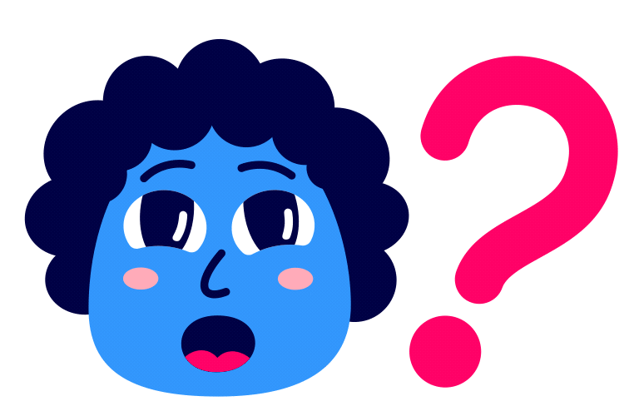
Q&A time...
READY SET
GROW!
More questions?
Write it down on a piece of paper and put it in the question envelope. We’ll answer a few today and save the rest for next time.

Slide 58

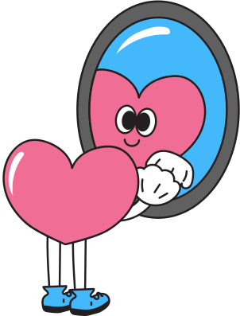
Reflection and wrap-up
READY SET
GROW!
Think about one thing you learned today or one thing you’ll share with a friend.
Write or draw your response in your workbook.
Circle how you feel about today now:

Slide 59

Congratulations
READY SET
GROW!
You have just completed...
Remember, you’re not alone, and it’s okay to ask questions
Session 2
GROWING UP
What's happening to my body?

