Slide 1

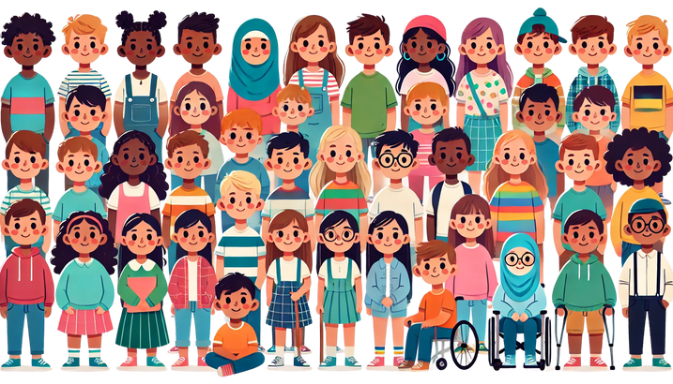
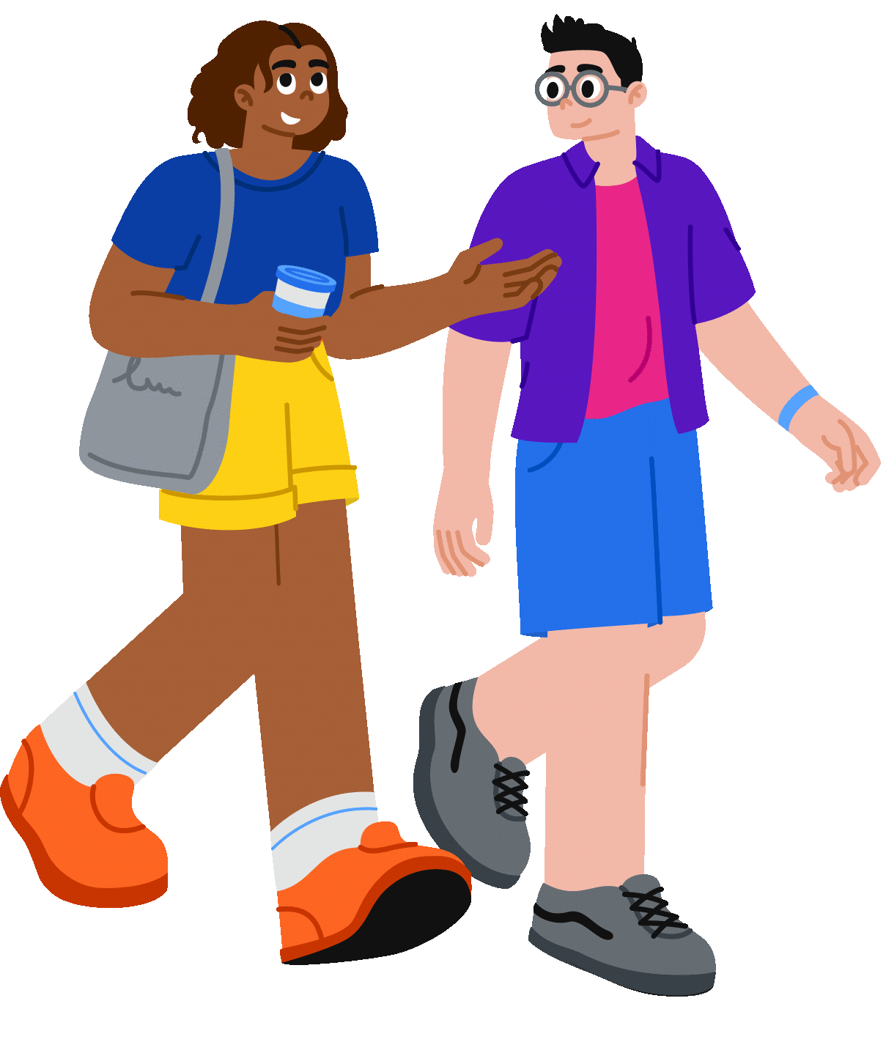

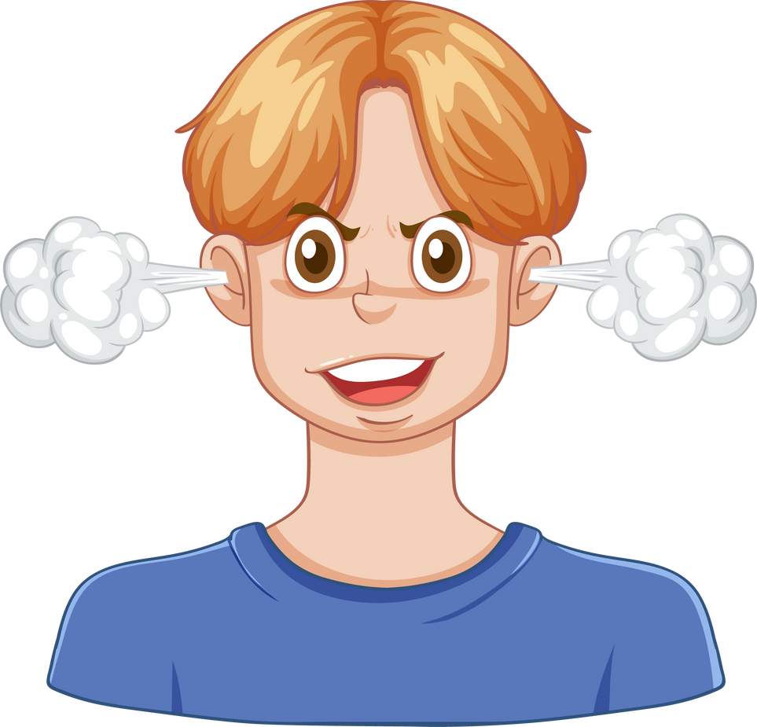




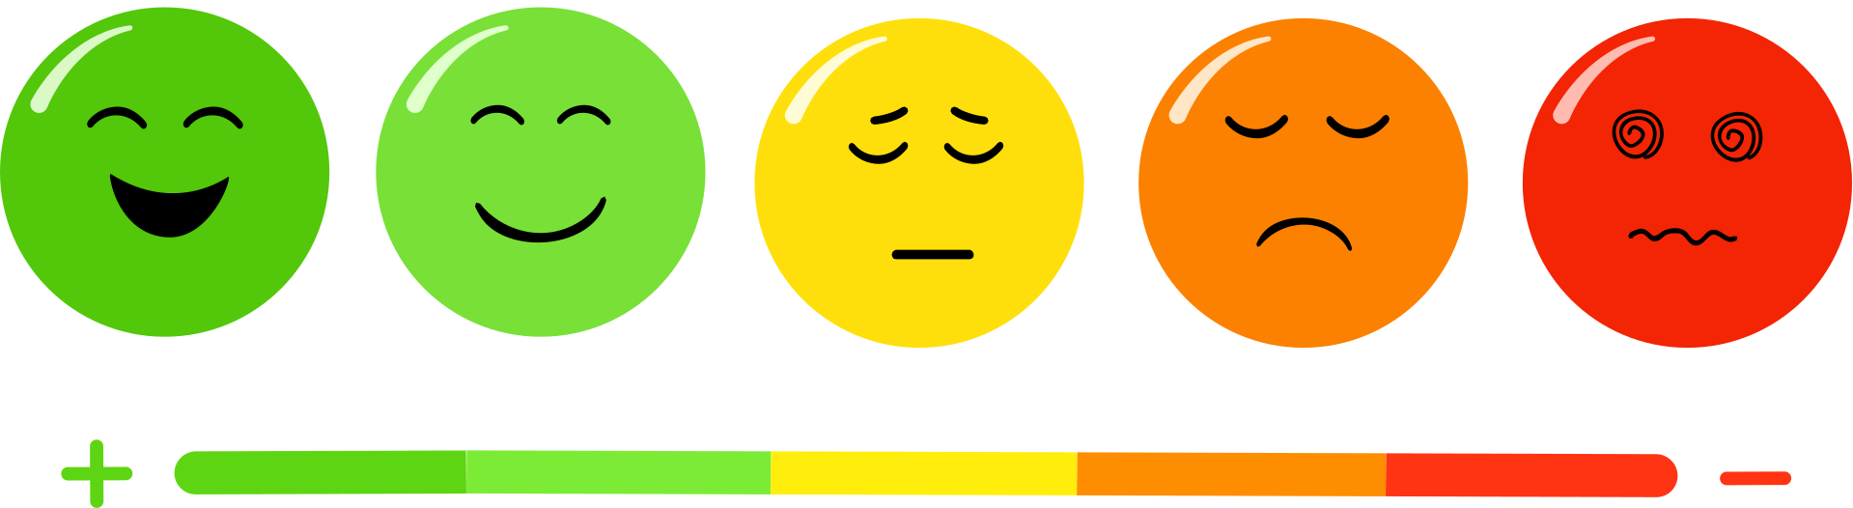




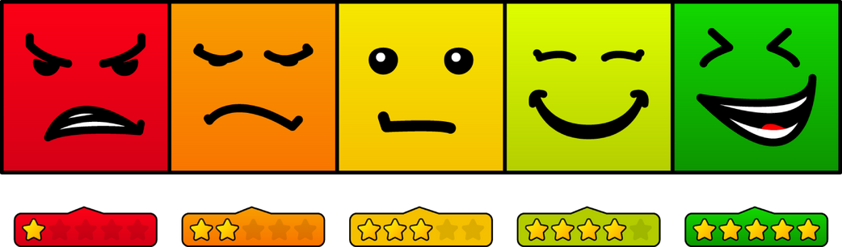
Ready Set Grow! Mood Board
READY SET
GROW!
Core Themes & Values
Imagery Style
Tone & Fonts
Inclusive
Safe
WARM AND HONEST
Empowered
Respectful
INCLUSIVE
Energetic & Fun
Real & Positive
Clear, age-appropriate
Friendly and open
Confident
Belonging
Strength-Based
Colour Palette
Visuals & Icons

